Slide 1

AYODHYA RAM Mandir COMMENTS ANALYSIS
PRESENTED BY- PRADNYA YASHWANT SUTAR
PGA- 44
CAPSTONE-2

Slide 2
INTRODUCTION
Title: Exploring Opinions on Ram Mandir: NLP Dive
Introduction:
In this project, we're using computer smarts (NLP) to understand what people think about the Ram Mandir online. We want to figure out if folks are feeling positive, negative, or neutral about it. By studying comments, we aim to discover the main topics people are talking about and grasp the different viewpoints on the Ram Mandir. This helps us get a clear picture of what's buzzing online and what people really think about this important topic.

Slide 3
OBJECTIVE
Perform sentiment analysis on the provided dataset, categorizing comments related to the Ram Mandir into positive, negative, or neutral sentiments.
Utilize Natural Language Processing (NLP) techniques to derive insights into the prevailing emotional tones expressed in the comments.

Slide 4
PROBLEM STATEMENT
The goal is to develop an effective sentiment classification model capable of accurately categorizing public sentiments as positive, negative, or neutral in the context of discussions about the Ram Mandir.
OR
The analysis seeks to provide valuable insights into the prevailing emotional tones expressed by individuals in online conversations surrounding this significant cultural and religious topic.

Slide 5

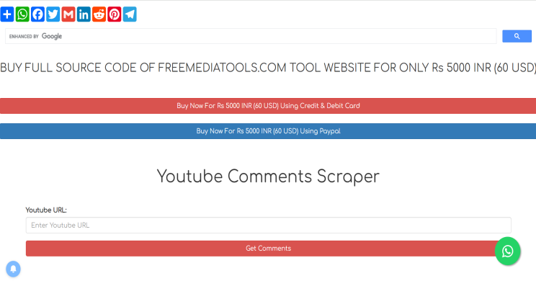




DATA GATHERING
Youtube
Comment Scrapper
Data
Json To Csv Converter

Slide 6
STEPS TO CREATE MODEL
1.Import Necessary Liabraries
2.Data Pre-processing
3.Exploratory Data Analysis (EDA)
4. Feature Extraction
5. Model Building
6.Evaluate the model

Slide 7
Data Overview
Data Contains three columns which are
1 Person Name
2 Time
3 Comments
Total Data Contains 8413 Comments or (Rows)

Slide 8
1.Import Important Libraries
import pandas as pd
import numpy as np
from translate import Translator
import re
from sklearn.model_selection import train_test_split
from sklearn.feature_extraction.text import TfidfVectorizer
from imblearn.over_sampling import RandomOverSampler
from sklearn.model_selection import GridSearchCV

Slide 9
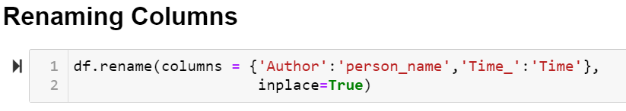
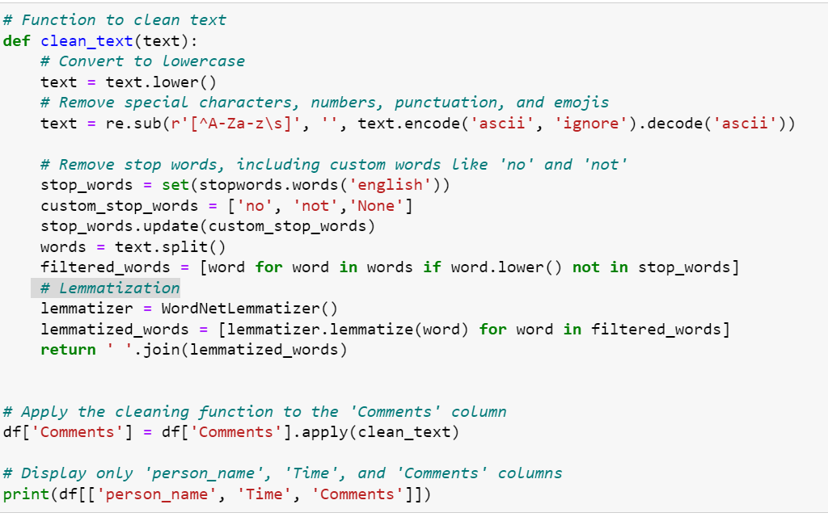
2.Data Preprocessing
A. Data Cleaning:
Renaming Columns
Handling missing values
B. Text Cleaning:
Remove special characters, numbers, and punctuation and emoji
Remove stop words
Lemmatization and lower text
Language Labeling
Translate the Comments into English

Slide 10
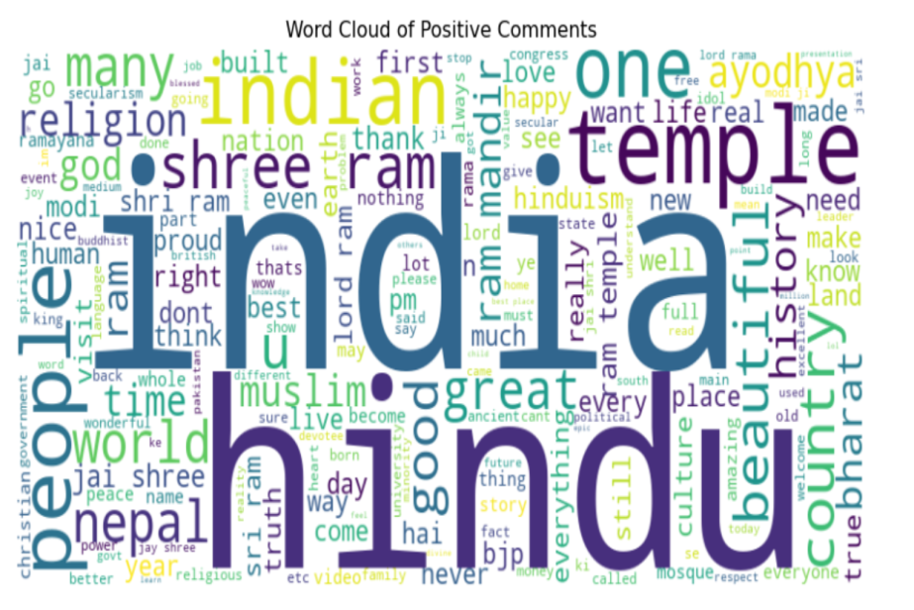
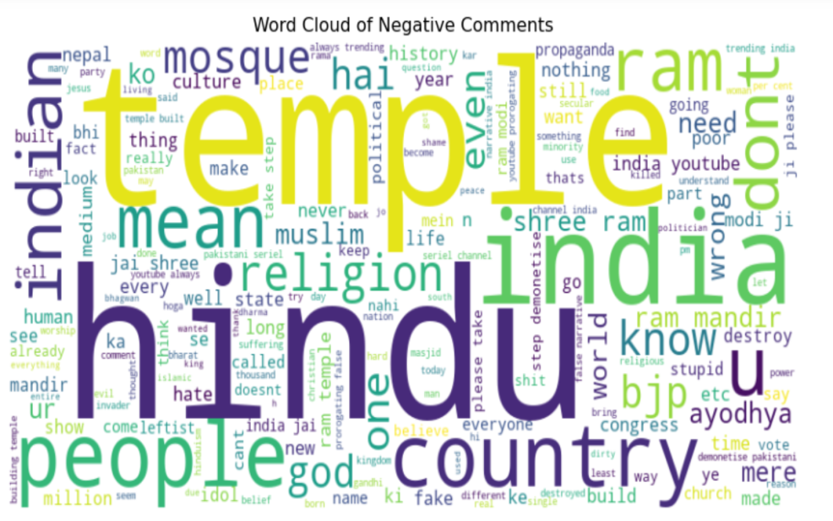
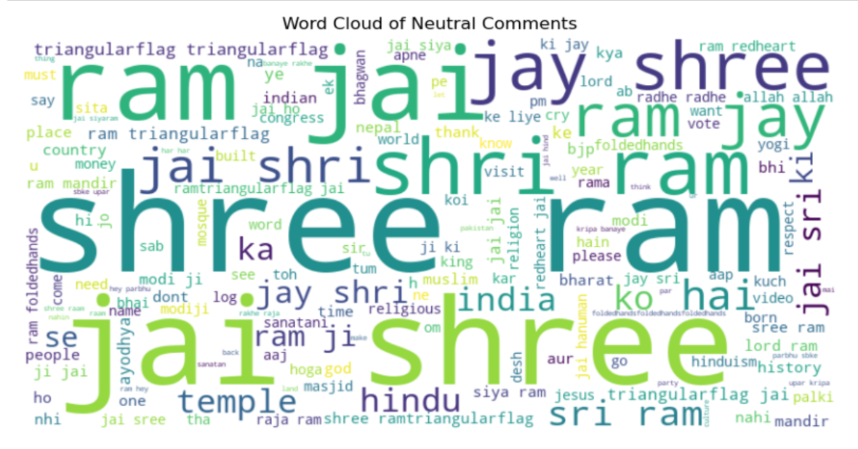
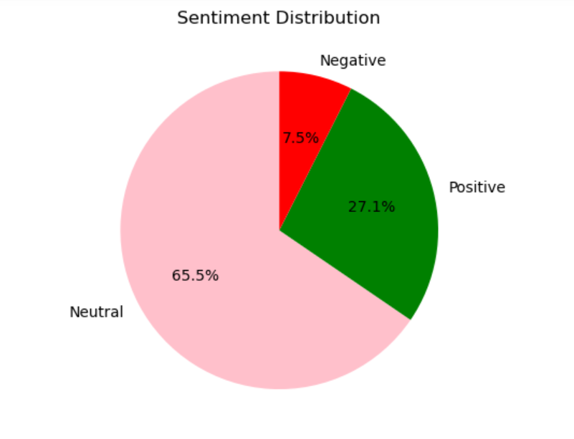
3. Exploratory Data Analysis (EDA)
a. Word Cloud:
b. Sentiment Analysis:
Neutral Comments
Positive Comments
Negative Comments

Slide 11
4. Spliting Data into Train And Test
80% Data in Train
20% Data in Test
5. Feature Extraction:
TF-IDF Vectorization:
Convert the text data into numerical format using TF-IDF vectorization.

Slide 12
6. Model Building
1.Logistic regression Model
2.Random Forest Classifier
3. SVM Classifier
4.Naive Bayes Classifier
5.KNN Classifier
6.AdaBoost Classifier
7. Gradient Boosting Classifier

Slide 13
7.MODEL EVALUATION
Name Of Model | Base Model Accuracy | Hyper Parameter tunning Accuracy
1.Logistic regression Model | 0.9062087186261559 | 0.9062087186261559
2.Random Forest Classifier | 0.8982826948480845 | 0.8989431968295905
3. SVM Classifier | 0.9055482166446499 | 0.9114927344782034
4.Naive Bayes Classifier | 0.7410832232496698 | 0.7410832232496698
5.KNN Classifier | 0.7516512549537648 | 0.7813738441215323
6.AdaBoost Classifier | 0.8461030383091149 | 0.8553500660501981
7. Gradient BoostingClassifier | 0.8302509907529723 | 0.9128137384412153

Slide 14
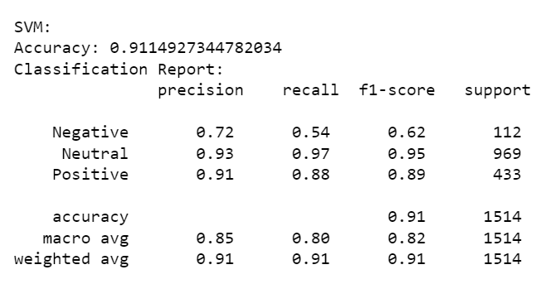
8.Best Model
Model Name: SVM Classifier
Accuracy for base model is about 90%
And
Accuracy before hyper parameter tunning becomes 91%

Slide 15
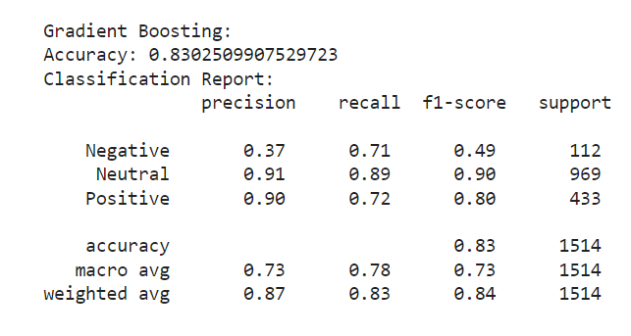
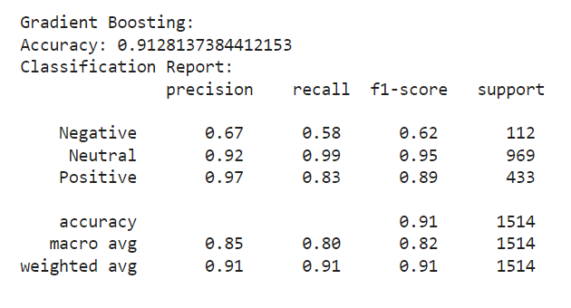
Best Model: Gradient Boosting
Model Name: Gradient Boosting Classifier
Accuracy for base model is about 83%
And
Accuracy before hyper parameter tunning becomes 91%

Slide 16
CONCLUSION
The sentiment analysis provides valuable insights into public sentiment regarding the Ram Mandir issue.
The Gradient Boosting model appears to be effective in sentiment analysis of Ram Mandir comments, especially for neutral sentiments.
The high accuracy and F1-score for neutral comments indicate that the model is robust in capturing the majority sentiment expressed in the comments.

Slide 17
Business point of view
sentiment analysis provides the government with valuable insights for
effective crisis management
threat assessment,
and strategic resource allocation.
By understanding public sentiments
the government can enhance security measures
maintain social stability
and foster a secure environment

Slide 18
THANK YOU

